Slide 1



AI Health Diagnosis System

Slide 2
Presented By
Muhammad Ahmad Ijaz (233566)
Abubakar (233534)
Muhammad Umer (233538)
Abdul Moueed Alvi (233536)

Slide 3
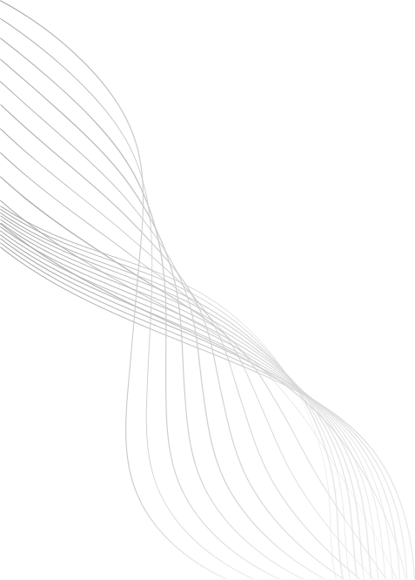
Introduction
AI-based health diagnosis web system
Predicts diseases from user symptoms
Uses Machine Learning (SVM)
Fast and user-friendly interface
Provides health guidance support
01

Slide 4
Problem Statement
Lack of instant medical guidance
Delayed doctor appointments
Unreliable online symptom searches
No confidence or severity indicators
Risk of wrong self-diagnosis
02

Slide 5
Objectives
Accept user symptoms easily
Predict diseases using ML
Show confidence and severity
Provide medical recommendations
Ensure ethical AI usage
03

Slide 6
System Design
Three-tier system architecture
Frontend for user interaction
Backend for logic processing
ML model for predictions
REST API-based communication
04

Slide 7
Architecture Overview
Presentation layer (Frontend)
Application layer (Backend)
Intelligence layer (ML Model)
Client-server interaction
Modular and scalable design
05

Slide 8
ML Pipeline
Load medical dataset
Encode symptoms as features
Train SVM classifier
Evaluate model accuracy
Save trained model
06

Slide 9
API Endpoints
/predict for diagnosis
/get-symptoms endpoint
/get-diseases endpoint
/save-report endpoint
/get-metrics endpoint
07

Slide 10
Frontend Pages
Login and Signup page
User dashboard
Diagnosis page
Reports history page
Disease information page
08

Slide 11
Technology Stack
Python for backend
Flask framework
HTML, CSS, JavaScript
scikit-learn library
Chart.js visualization
09

Slide 12
Backend Implementation (Flask API)
Flask REST API server
Loads ML model at startup
Handles prediction requests
Manages user authentication
Returns JSON responses
10

Slide 13
ML Model Training
Load symptom-disease dataset
Convert symptoms to binary form
Train SVM classifier
Calculate accuracy metrics
Save trained model
11

Slide 14
Prediction Pipeline
User symptom input
Binary vector generation
SVM disease prediction
Confidence score calculation
Return top results
12

Slide 15
Others Functionalities
User authentication system
Report saving feature
Voice symptom input
Error handling
Data visualization
13

Slide 16
Conclusion
AI health system successfully developed
SVM proved effective
Expand disease database
Add mobile application
Integrate doctor consultation
14

Slide 17
THANK YOU
15

